Slide 1

VSCode
Debugger Setup

Slide 2
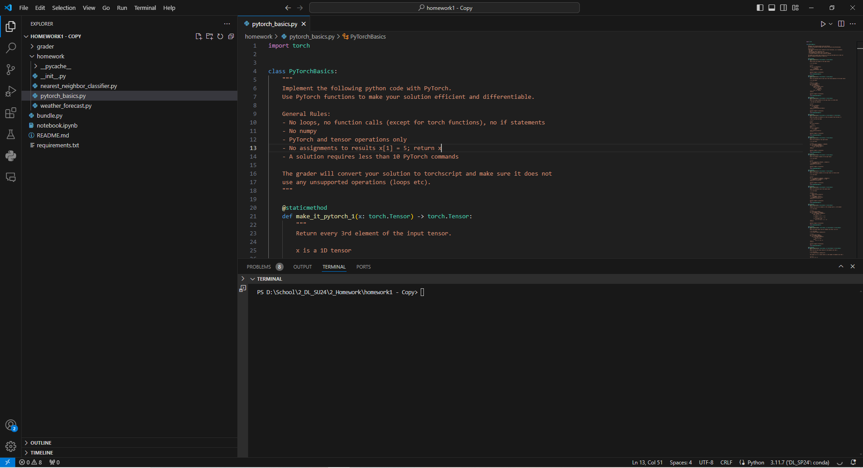
Open the “Extensions” Tab

Slide 3
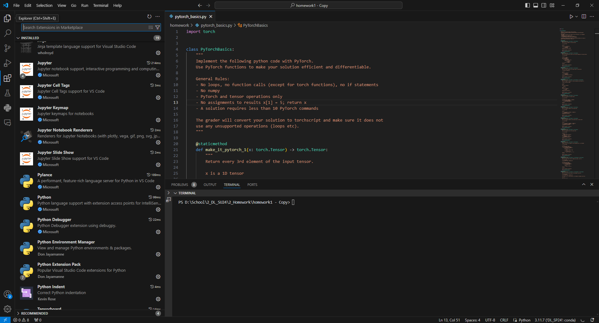
Install “Python Debugger” if you don’t already have it

Slide 4
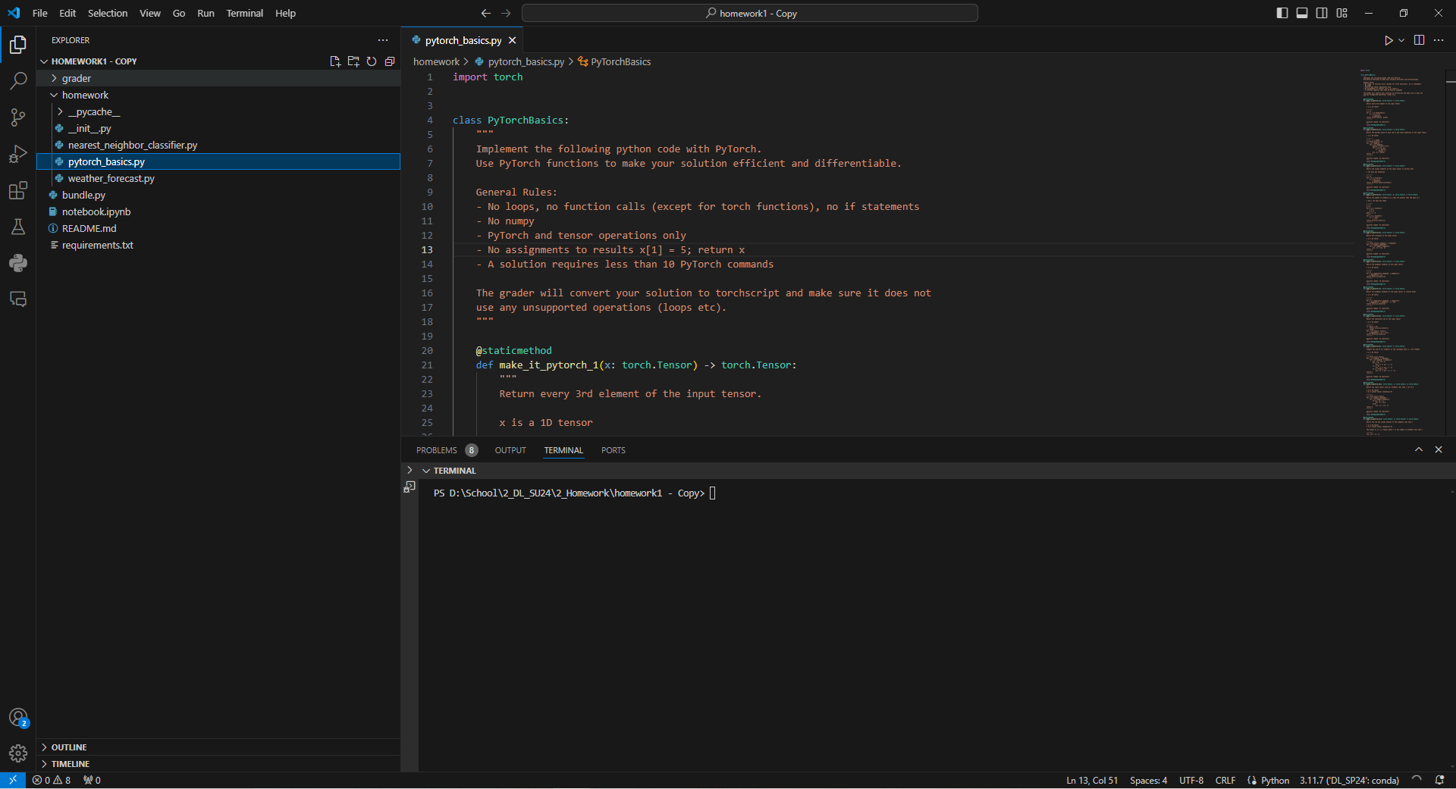
Open the “Run and Debug” Tab

Slide 5
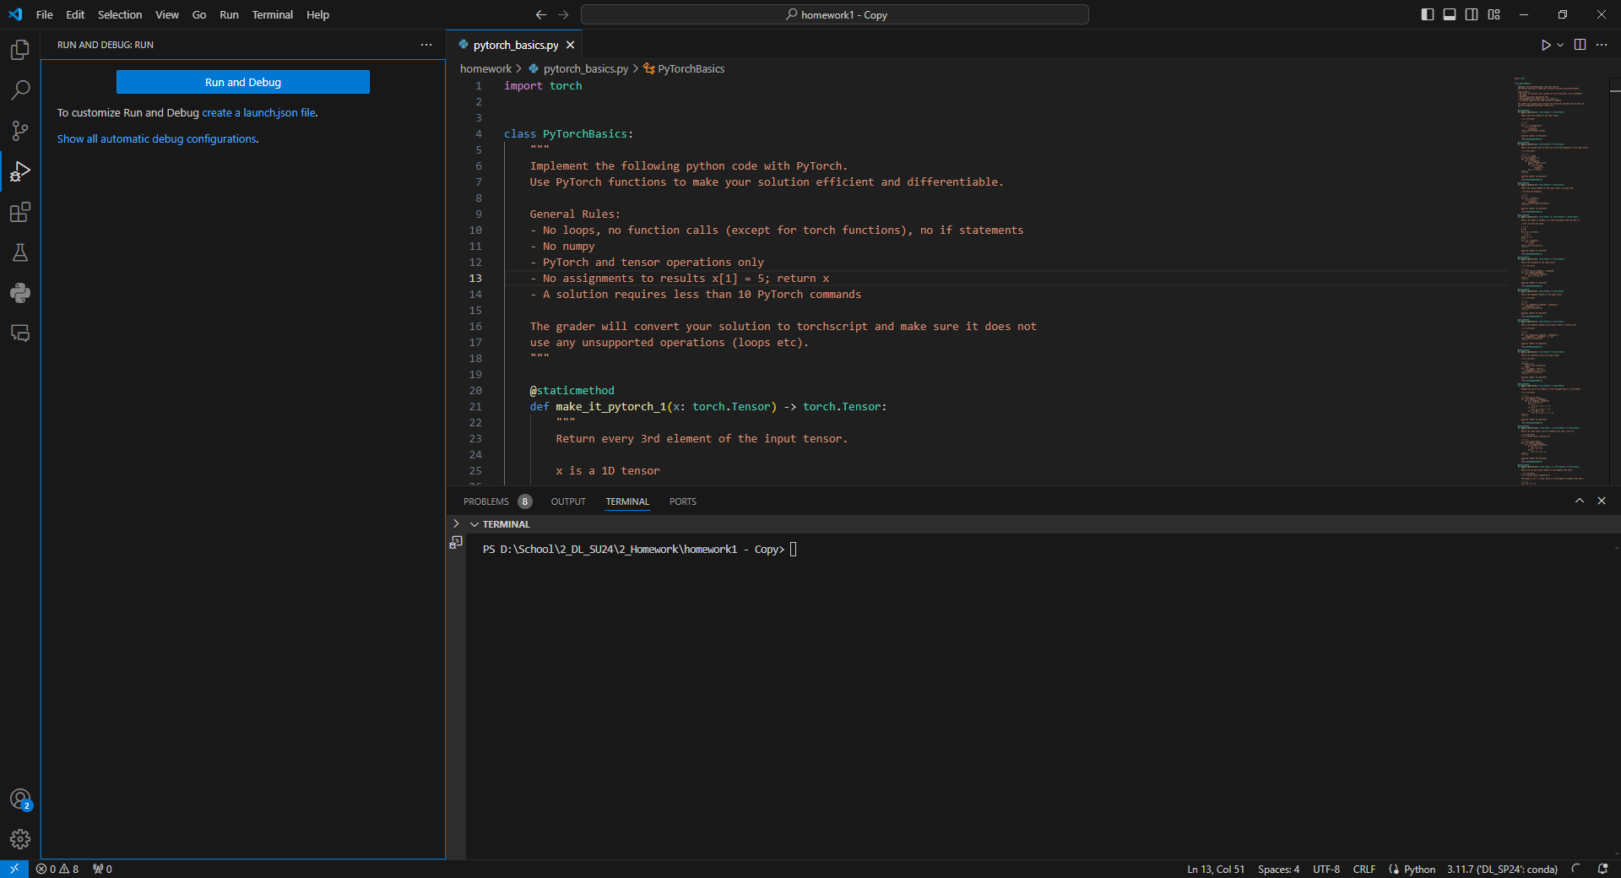
Left Click: “Create a launch.json file”

Slide 6
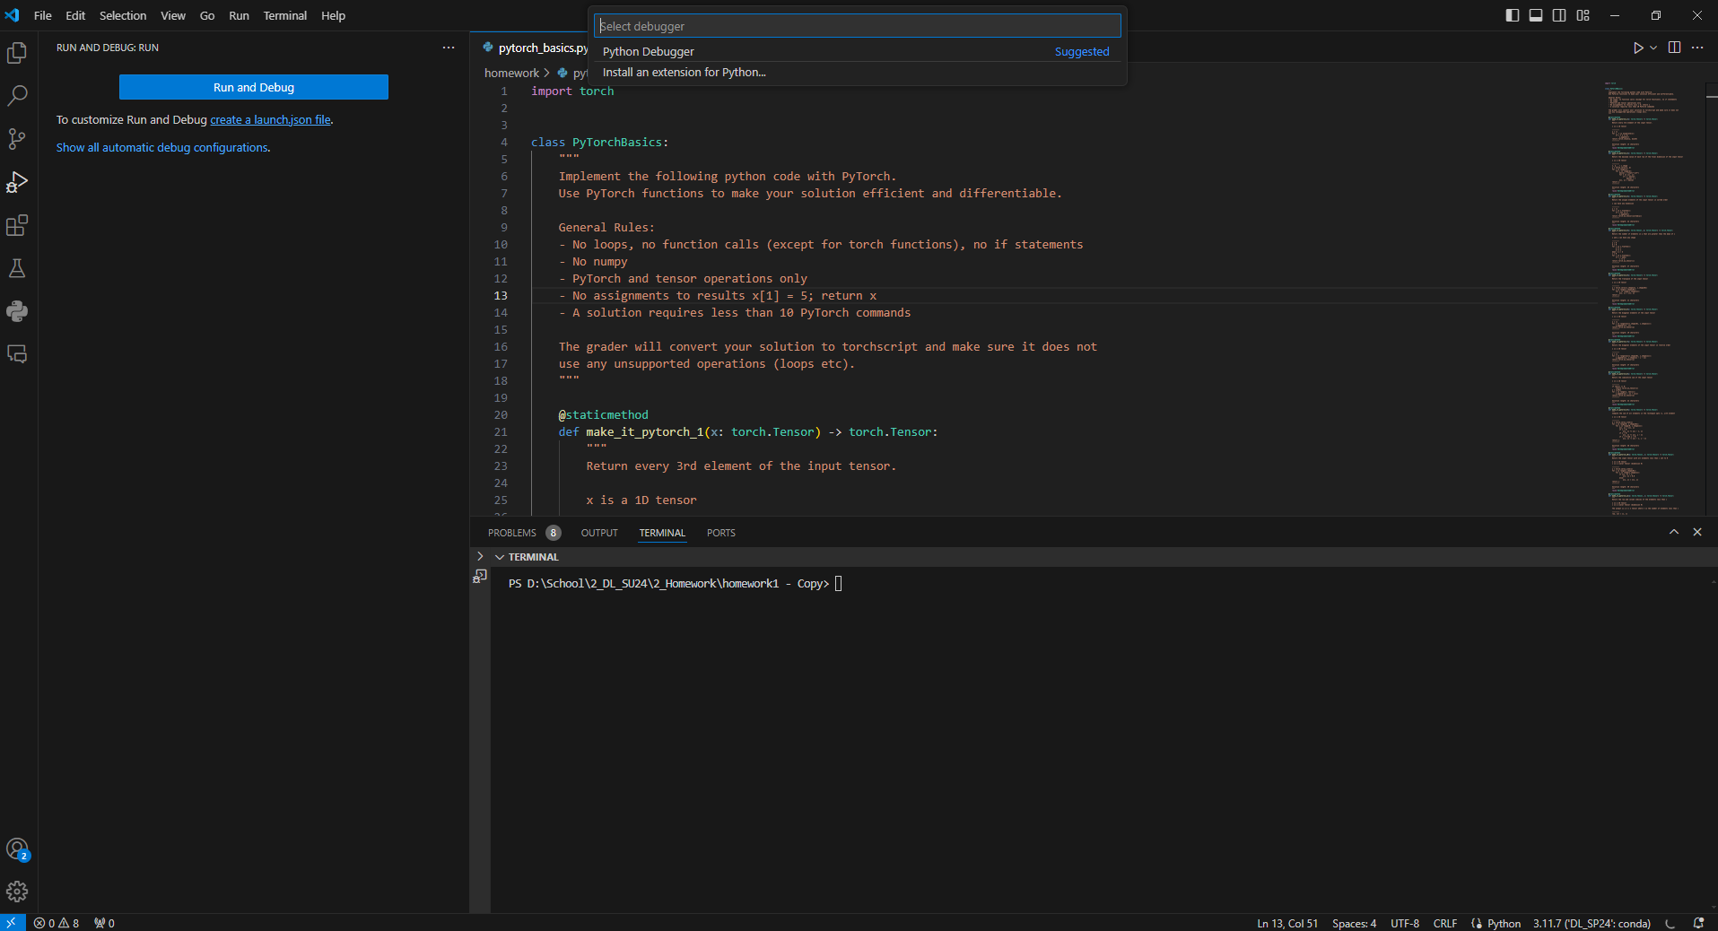
Left Click on “Python Debugger”

Slide 7
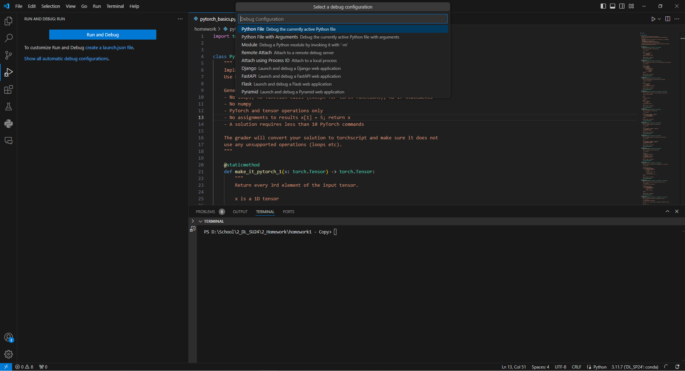
Left Click on:
“Module …”

Slide 8
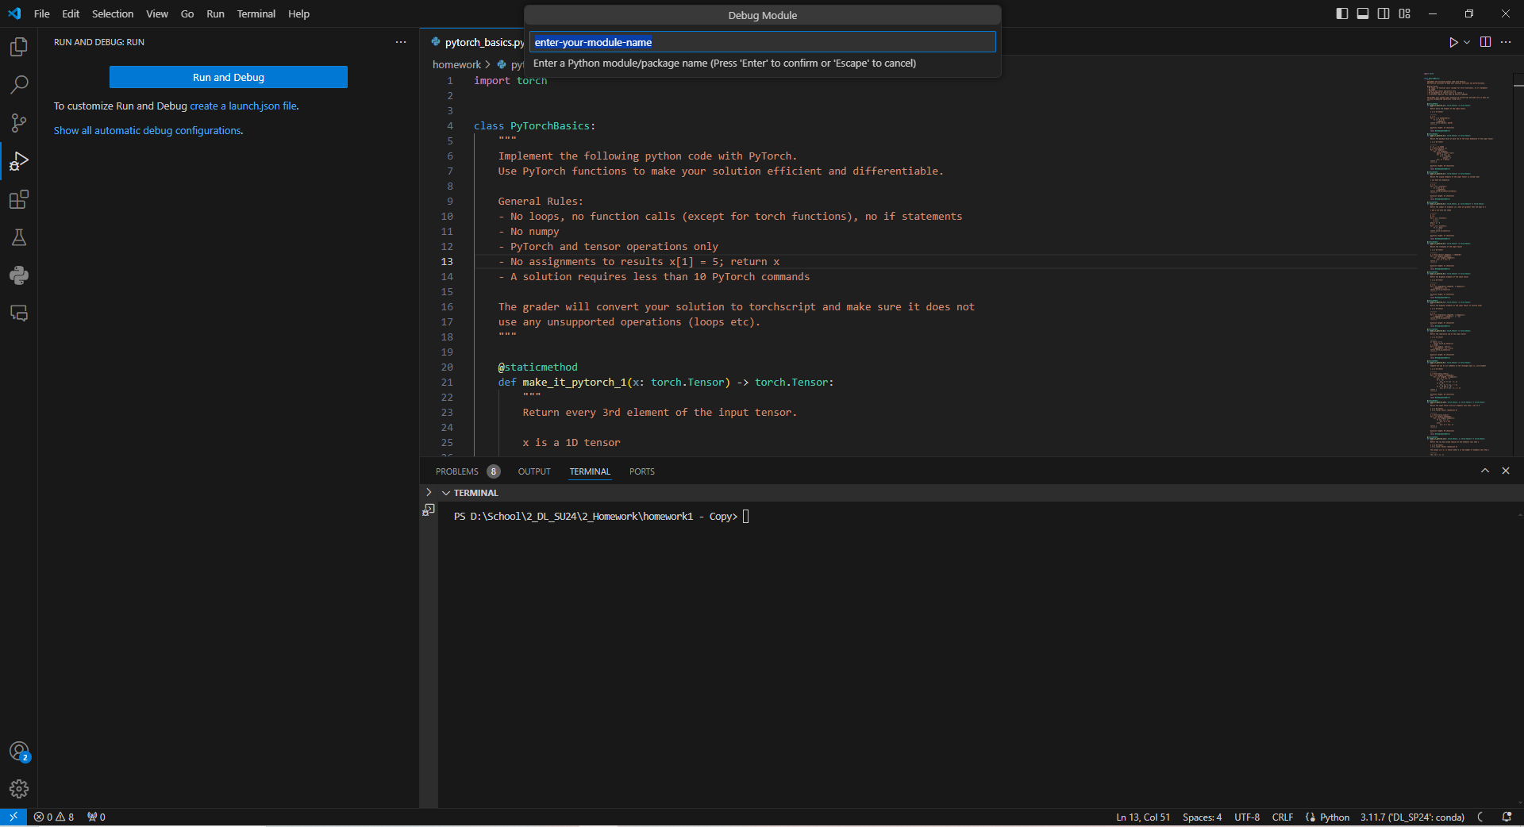
In the text box type: “grader”
Press Enter on the keyboard

Slide 9
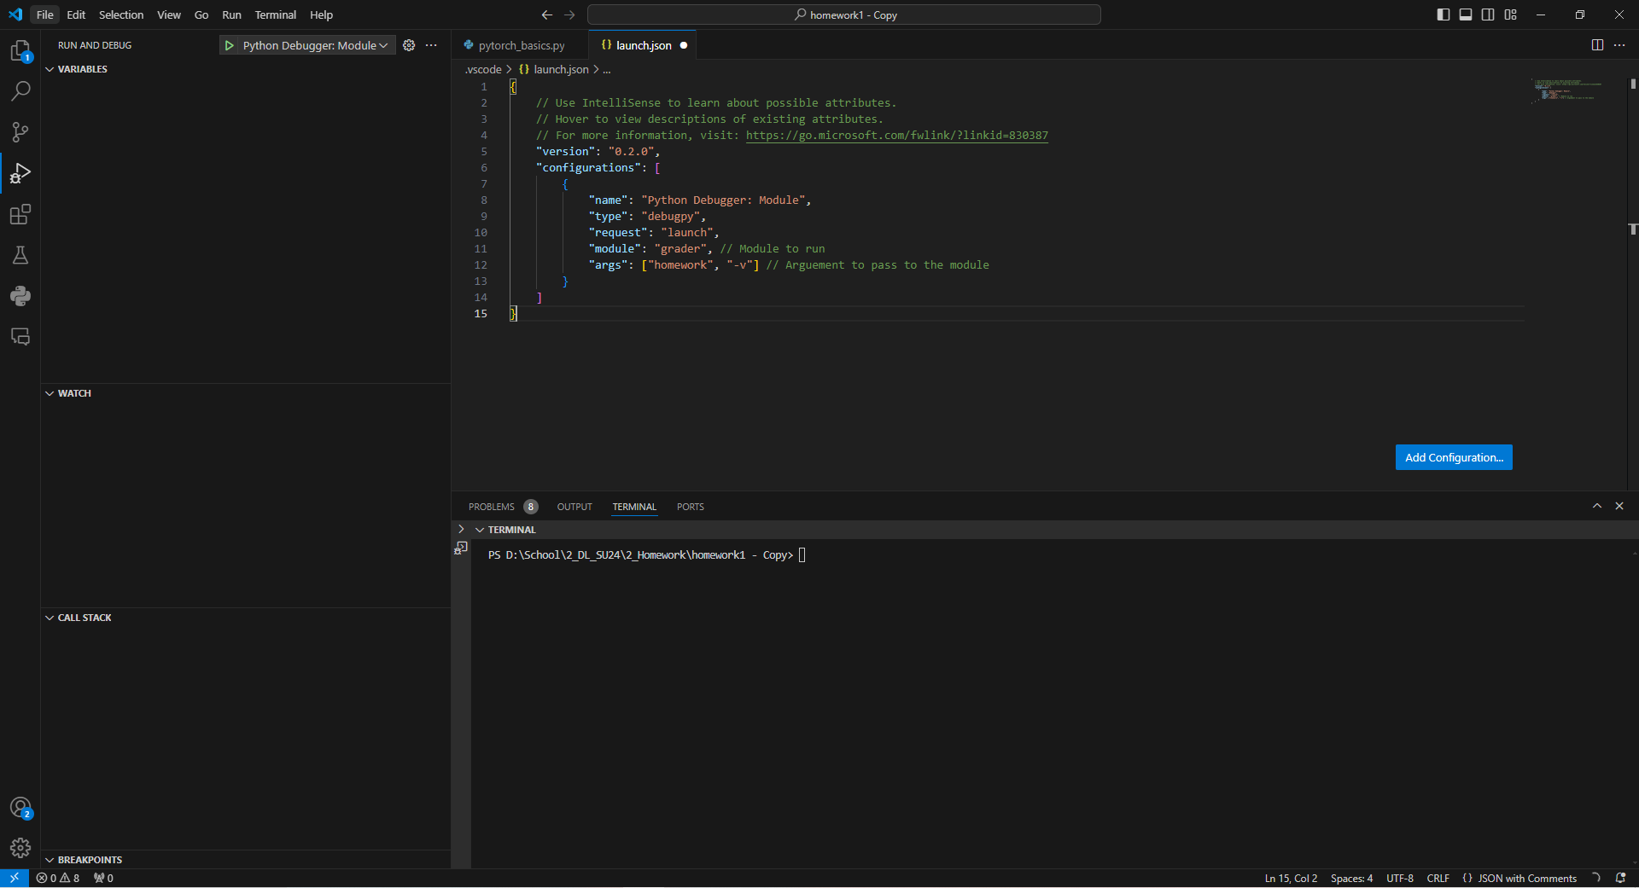
Add a comma to the end of: “module”: “grader”
Add a new line with:
“args”: [“homework”, “-v”]

Slide 10
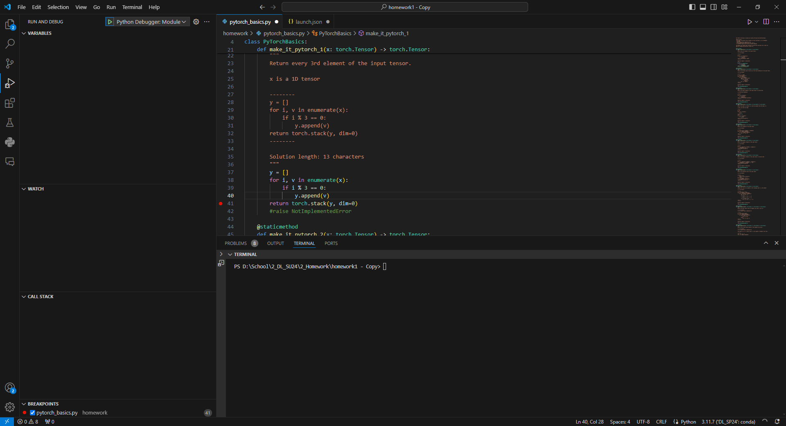
Left click to the left of a
line of code to set a breakpoint

Slide 11

Left click the green arrow or press F5
to start the debugger

Slide 12
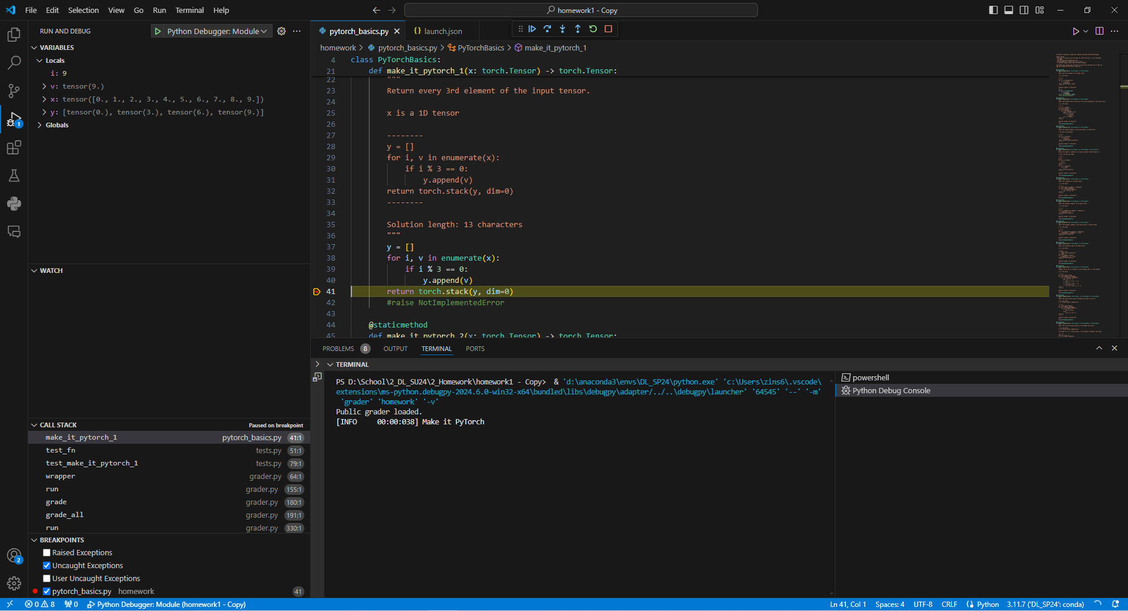
Variables Display

Slide 13
Debugger Controls

Slide 14
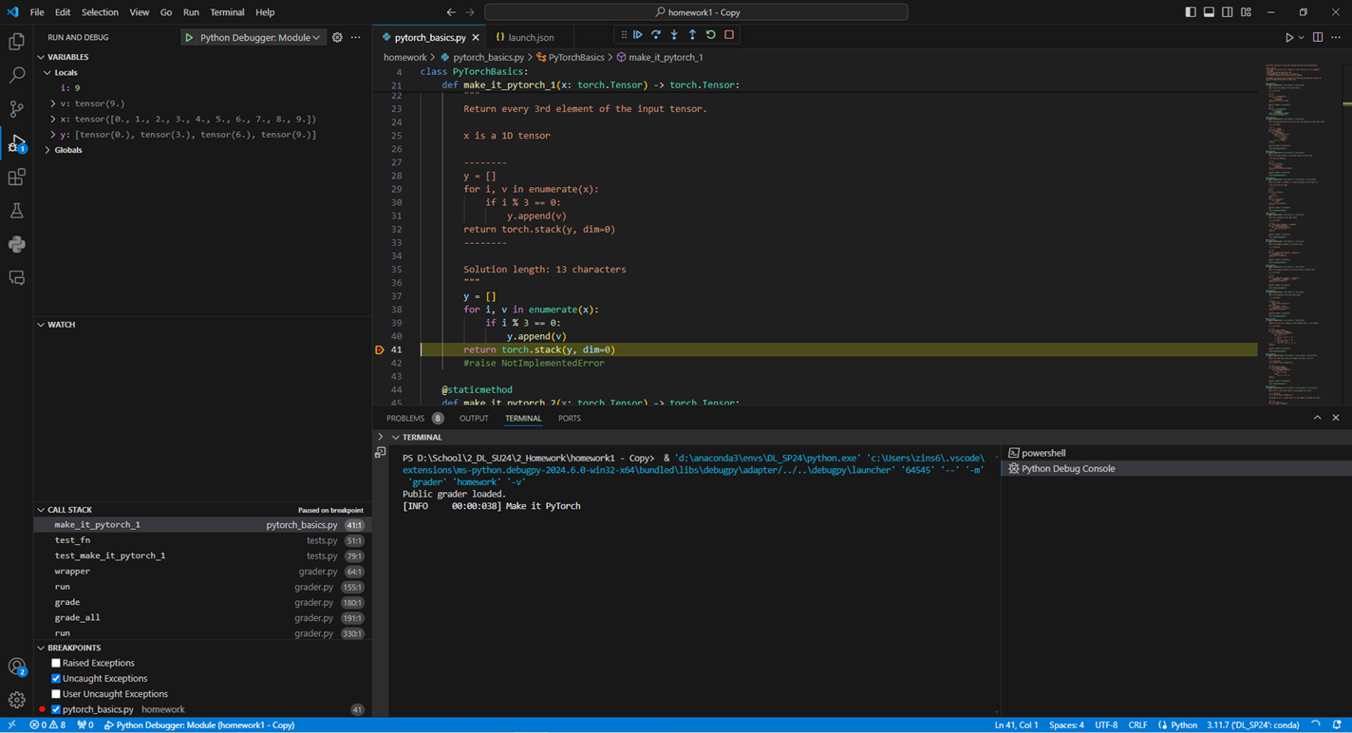
Open the Debug Console

Slide 15
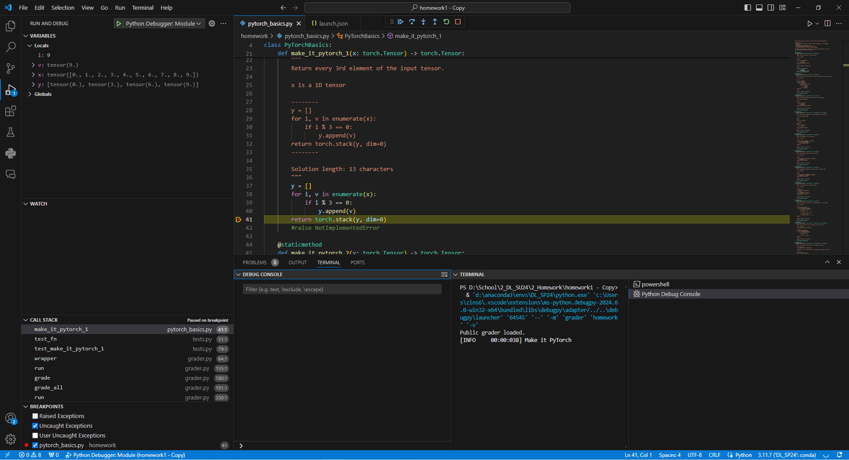
Type “x” into the Debug Console Prompt press enter

Slide 16

The “x” variable is printed to the console. Compare this to the Variables window

Slide 17
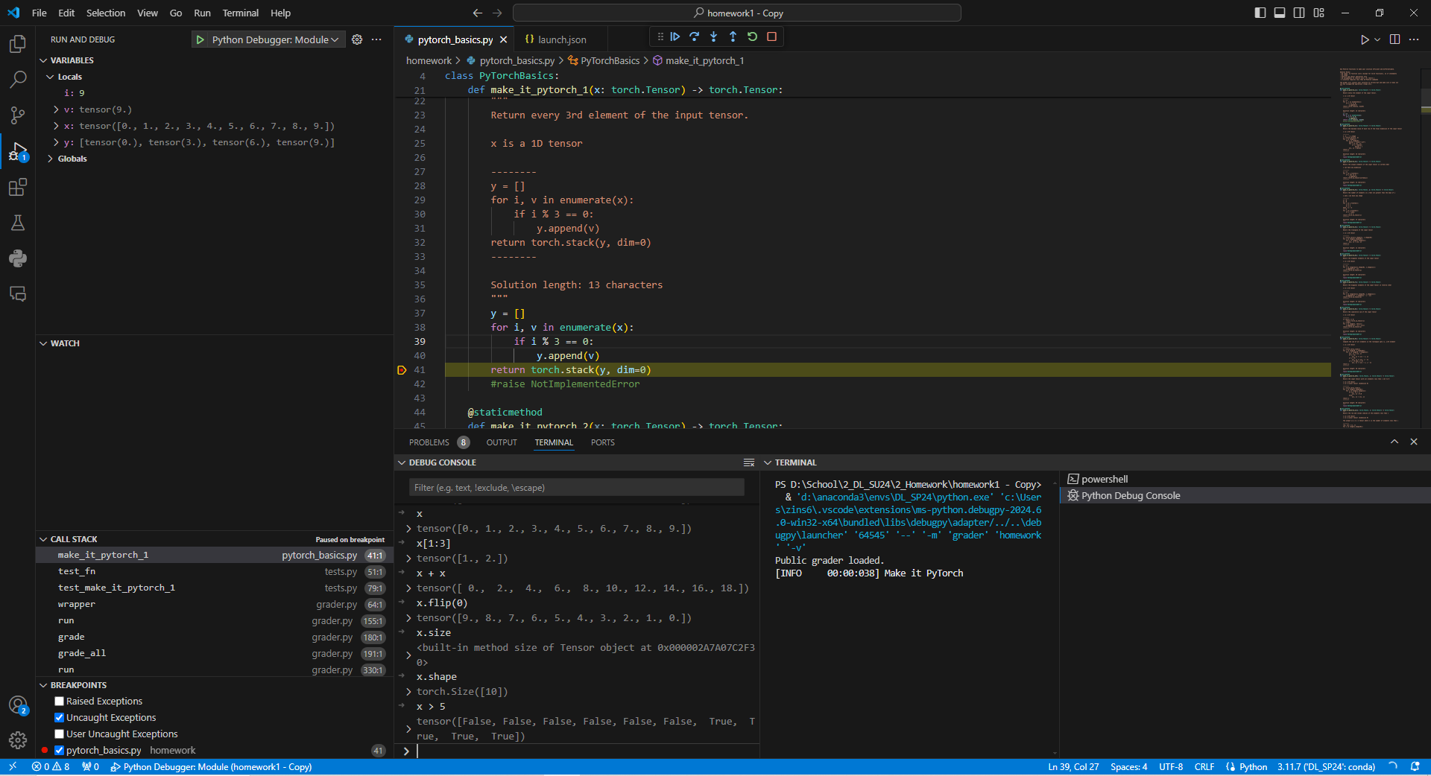
The Debug Console acts like a notebook. Experiment with different torch functions

Slide 18
References:
https://code.visualstudio.com/docs/editor/debugging

